Slide 1
Company Introduction
Shanghai Dikai Coding Technology Co., Ltd.
Jun. 2022

Slide 2
01
Company Profile
Contents
02
Product Category
03
Service System
04
Prospect

Slide 3
Company Profile
Part One
01
01

Slide 4

Overview
Dikai Group was founded in Shanghai in1995, has dedicated ourselves to innovation, manufacturing, sales and service of quality coding machines and consumables.
Our product portfolio including Thermal Transfer Overprinters, Laser Coders, Inkjets, Contact Coders and consumables like inks, ink rolls, ribbons and brass types.
Notes:
引领---成为标识行业引领者
极致---对外要超越同行，超过客户预期；对内永无止境追求卓越，超越自我
高效---高效是我们在全球竞争中后来居上的法宝；也是我们在竞争对手中脱颖而出的关键要素

Slide 5
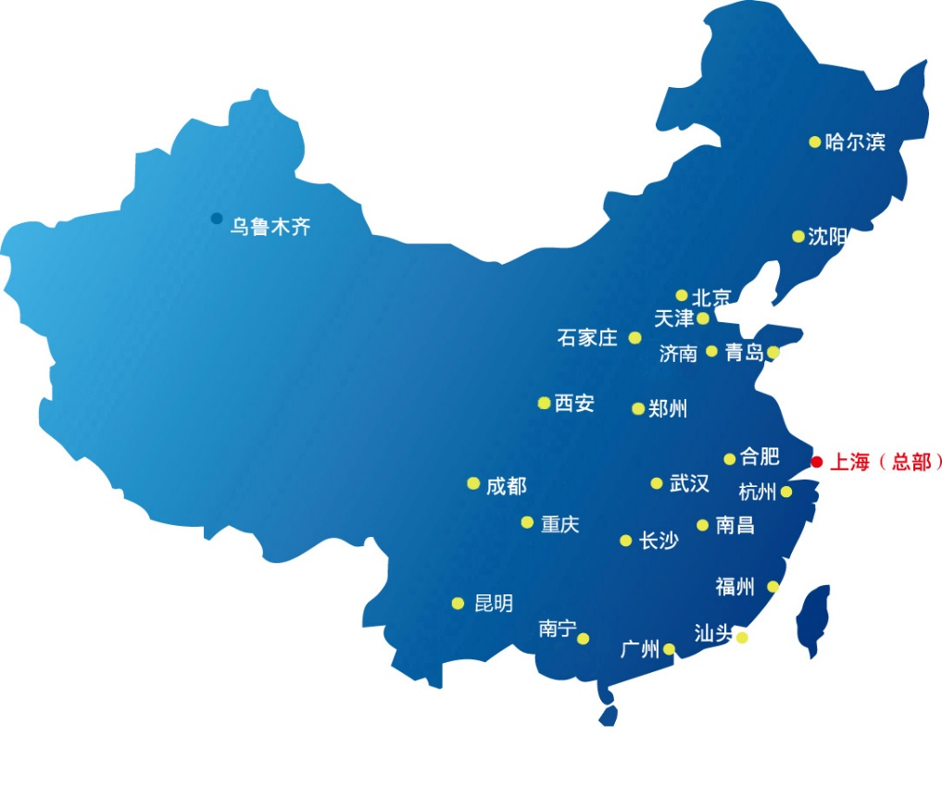
China Domestic Network
Headquarter in Shanghai
4 Branch Offices
13 Service Agents
Certificated distributors all over the main cities
Headquarter：
Shanghai

Slide 6
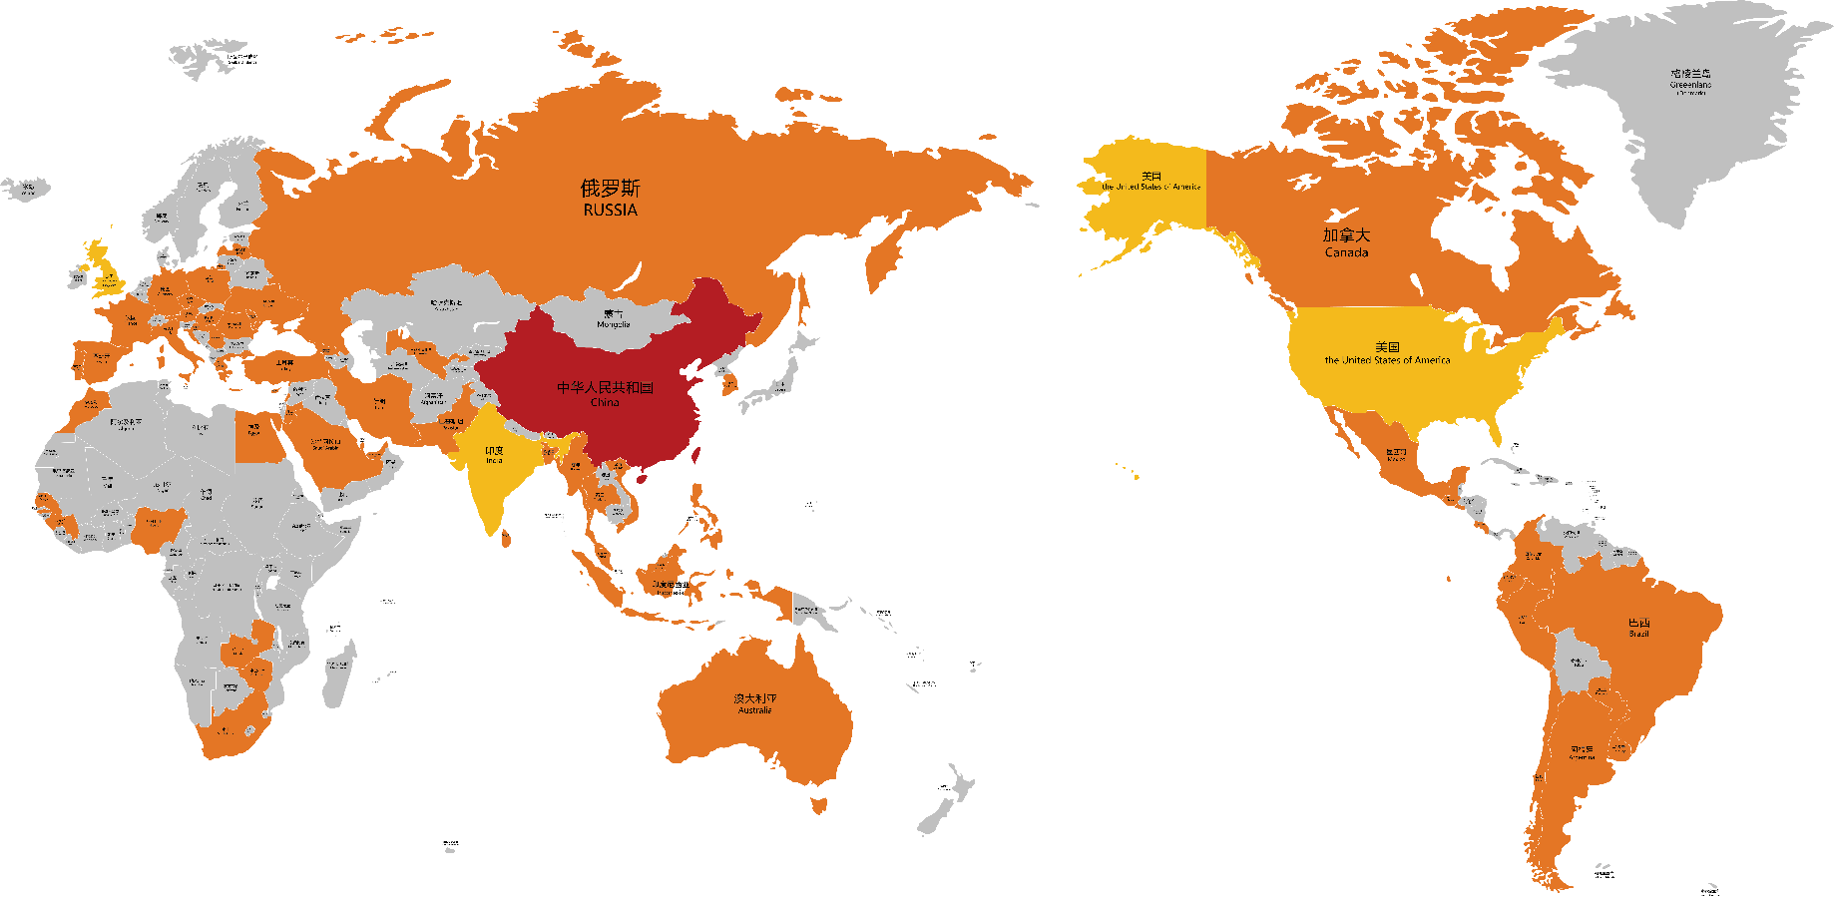
Overseas Distribution Network
Served more than 90 countries worldwide
Covered major econmies on all five continents
UK assembling factory start-up.
Establish subsidiaries in Mexico and Brazil soon.
India & US Service Agent building in progress
Sales and Service network is expending…

Slide 7
Vision & Mission
Positioning:
To be a leader in the global coding industry.
Leading
High Efficiency
Management:
Sustain high efficiency in global competition.
Product & Service:
Exceed customer expectations.
Pursue excellence.
Challenge ourselves.
Excellence

Slide 8

Dikai History
Developed Thermal Transfer Overprinter
Launched CIJ and new generation laser printer
2018
2011
Developed the first contact coder in China
2013
2022
Launched laser printer, TIJ, visual inspection system and Intelligent Printing Control System
Formulated industrial standards for contact coder
1995
1996
DiKai was established in Shanghai

Slide 9




Business Strategy
The core members of R&D team have more than 20 years of industry experience. Follow NPDP process in full life cycle, from product design, project management, R&D and process control, to continuous improvement and management excellence.
The production workshop implements 5S management and LEAN production model to fully ensure the quality of Dikai products.
R&D
Production
Sales
Service
Strengthen CRM and regional division, segment customer groups and build worldwide distribution network.
Over 25 years of technical service experience, more than 40 engineers across the country, offer 24/7 service.

Slide 10

Domestic Strategy
Cooperation
Opening
Customer
Oriented
Deeply cooperate with industrial pioneers
Share resources
Serve coding industry together
Create a coding application Ecosystem
Focus on the future development of the coding industry
Offer qualified services
Devote to the voice of customer and problem solving
Contribute to customers’ success

Slide 11
Oversea Strategy
Overseas
Globally
Localization
Become an International Solution Supplier
Implement global localization strategy.
Continuously expand product category and sales service channels.
Enhance overseas technical support.
Improve performance and adapt to overseas markets.

Slide 12

Marketing Strategy
Food & Beverage
Pharmaceutical
Industry
Coverage
Paper
Seeds
Daily Chemicals
Auto Parts
Logistics

Slide 13
Product Category
Part Two
02
02

Slide 14
Coding Technologies
TTO
P & A
Laser
Software Platform
CIJ & TIJ
Visual Inspection
Contact Coder
Consumables

Slide 15
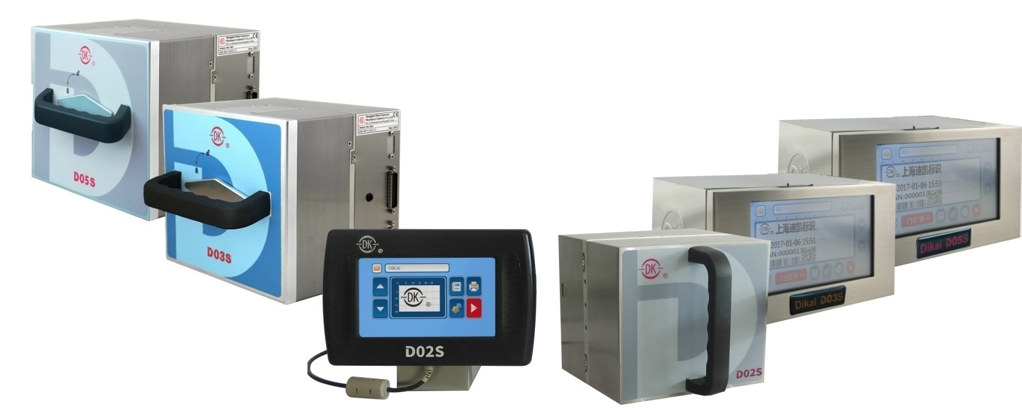
Thermal Transfer Overprinters
D series TTO

Slide 16
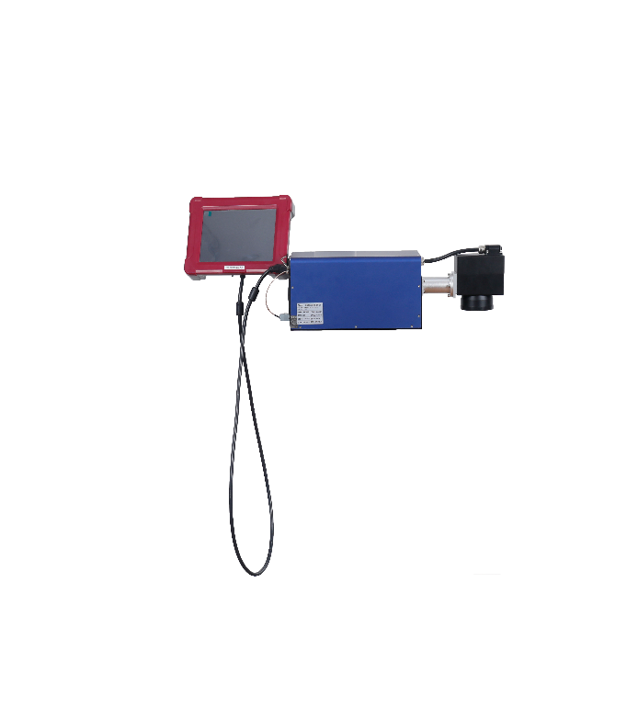
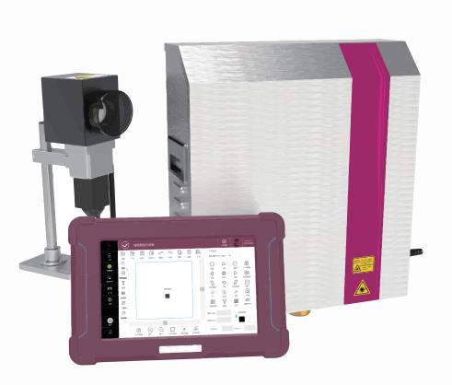
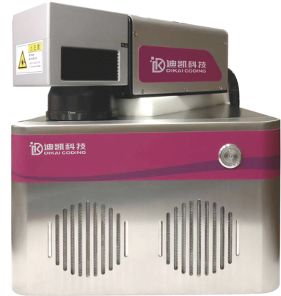
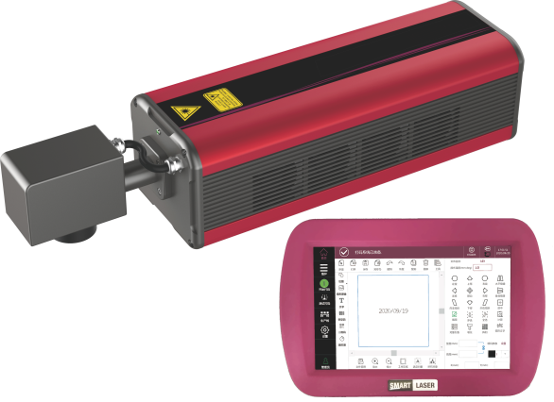
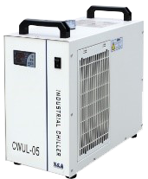
Laser Printers
DLF Fiber Laser
DLU UV Laser
DLC CO₂ Laser
DLES Entry Level
Fiber Laser

Slide 17
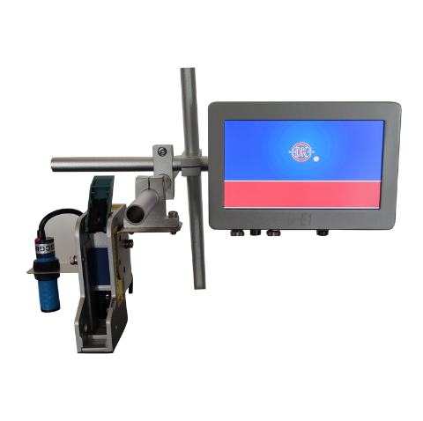
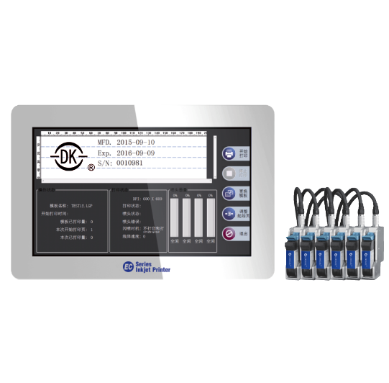
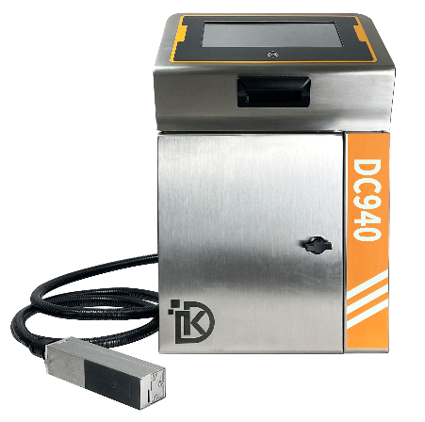
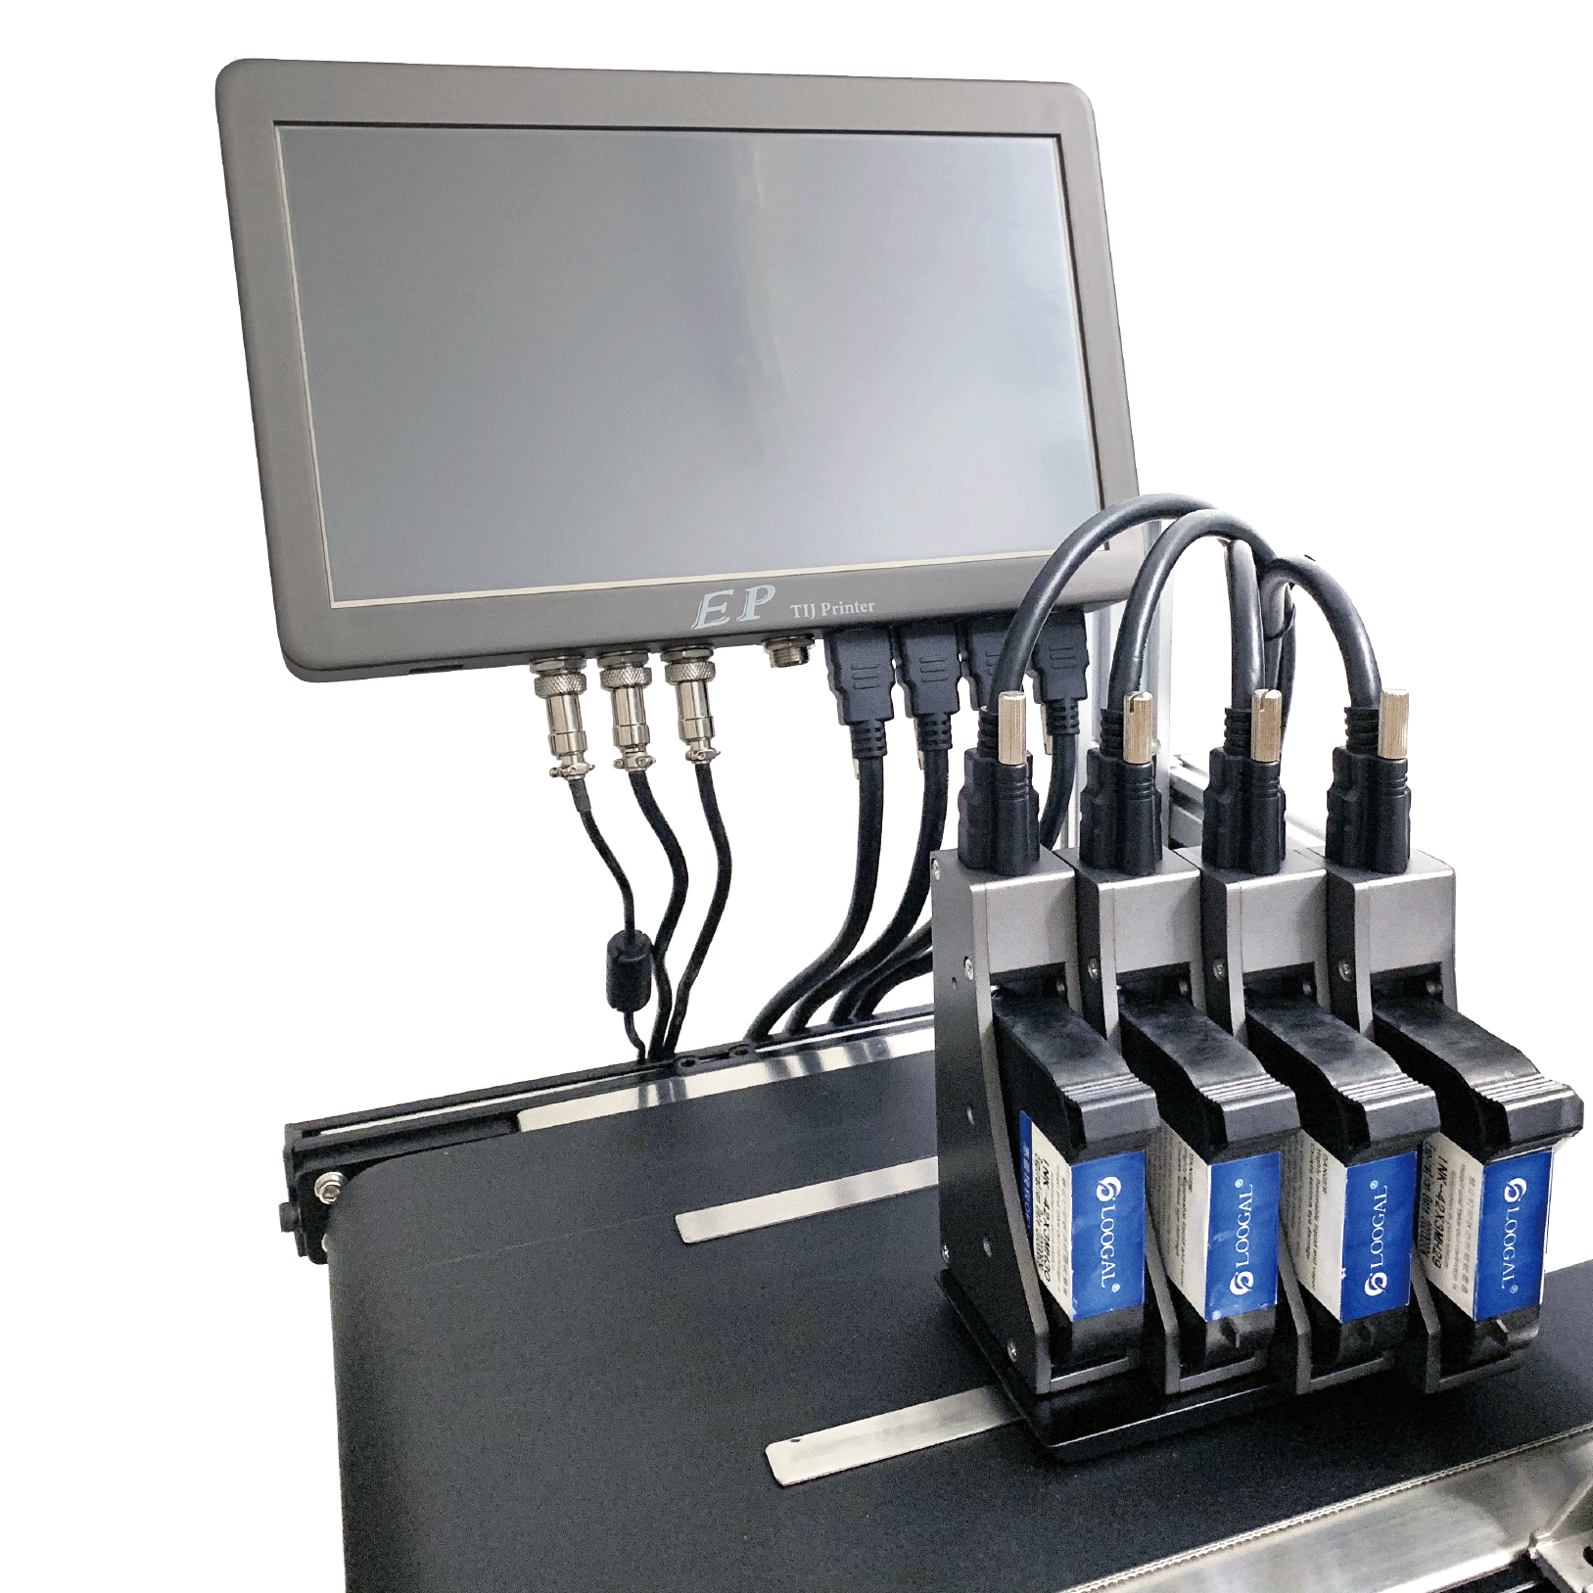
Continuous Inkjets/Thermal Inkjets
DC series CIJ
E series TIJ
ES series TIJ
EP series TIJ

Slide 18
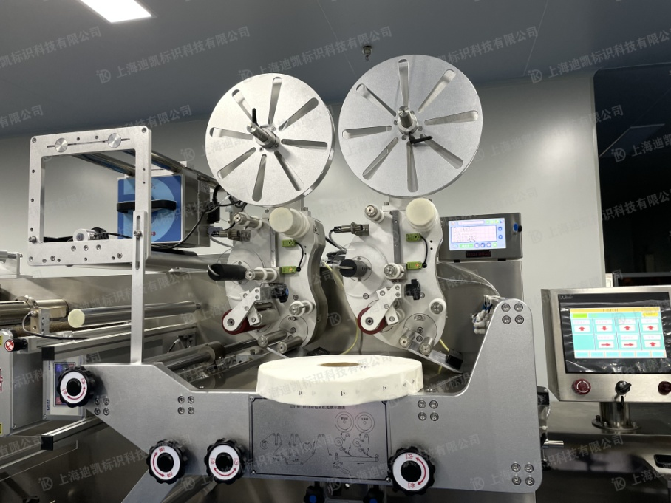
Print & Label System
DK Labelling Machine with Printer

Slide 19
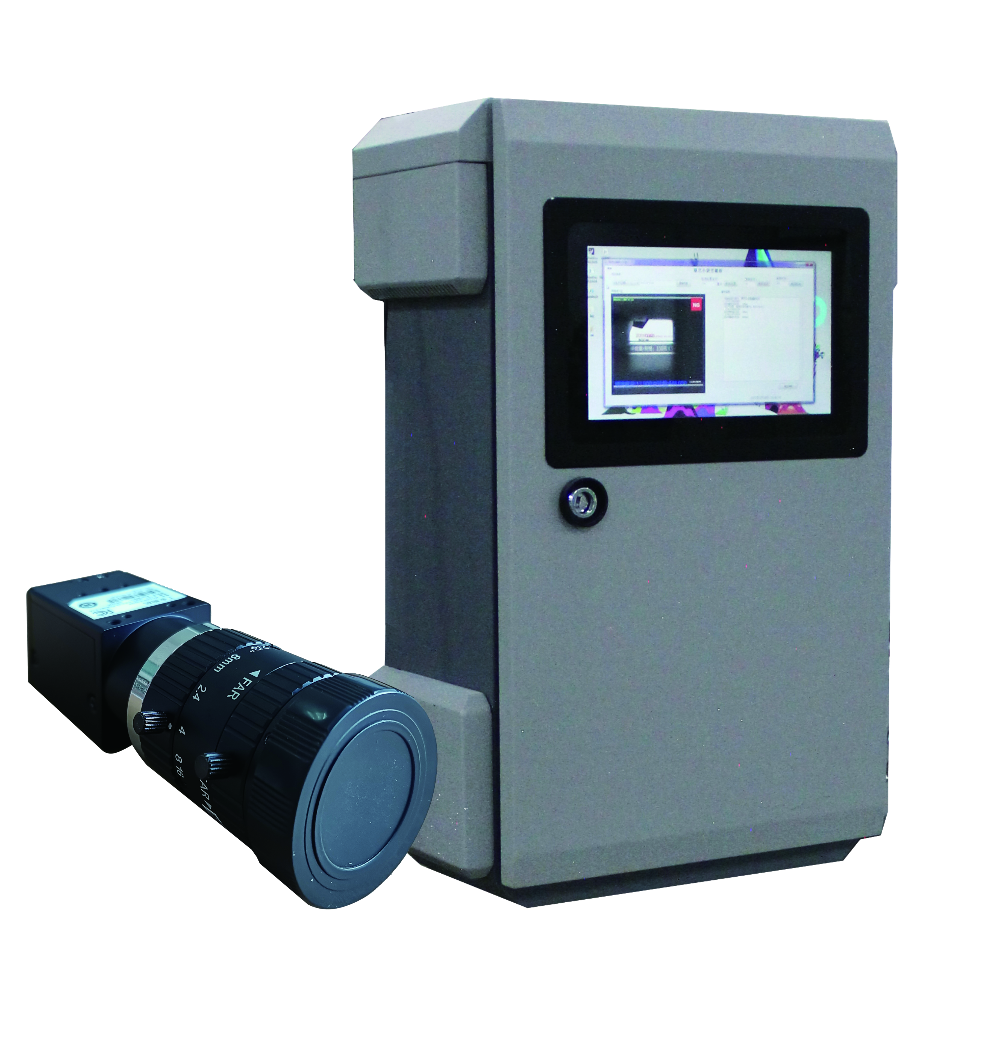
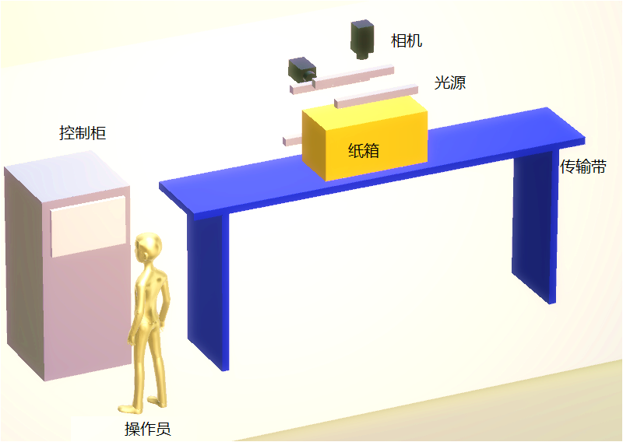
OCR System
DK Optical Character Recognition System

Slide 20
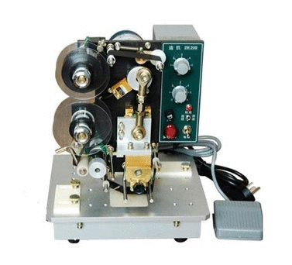
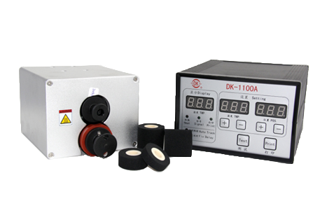
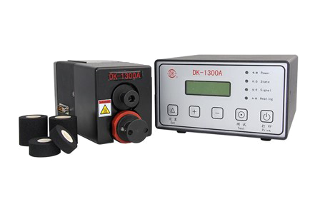
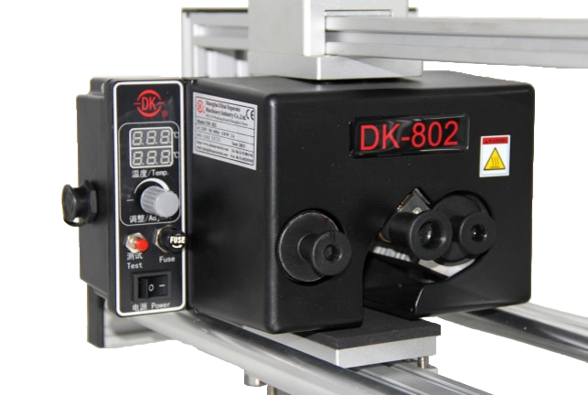
Contact Coders
DK-1100 series
DK-1300 series
DK-802
DK-200

Slide 21
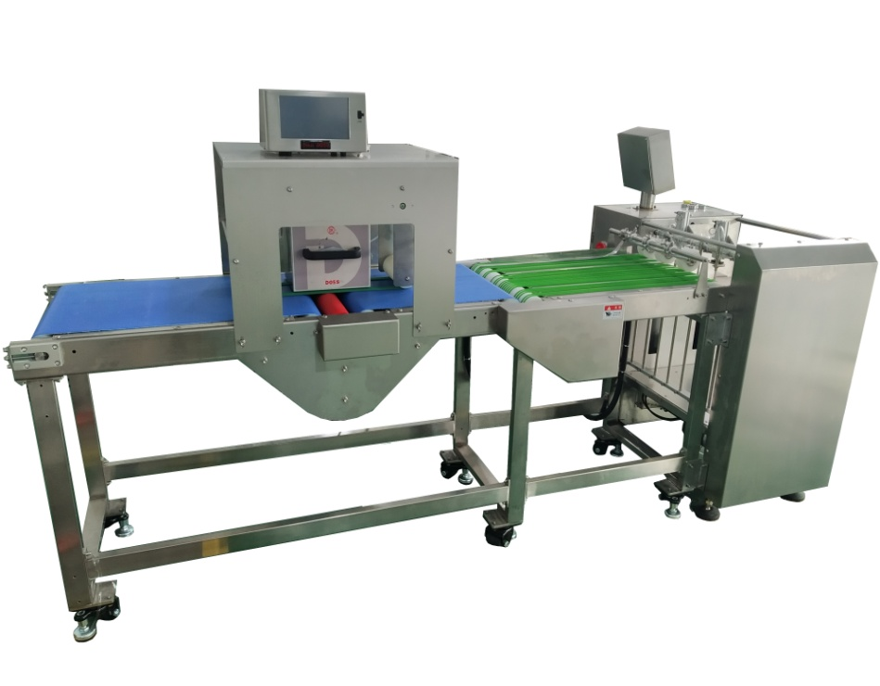
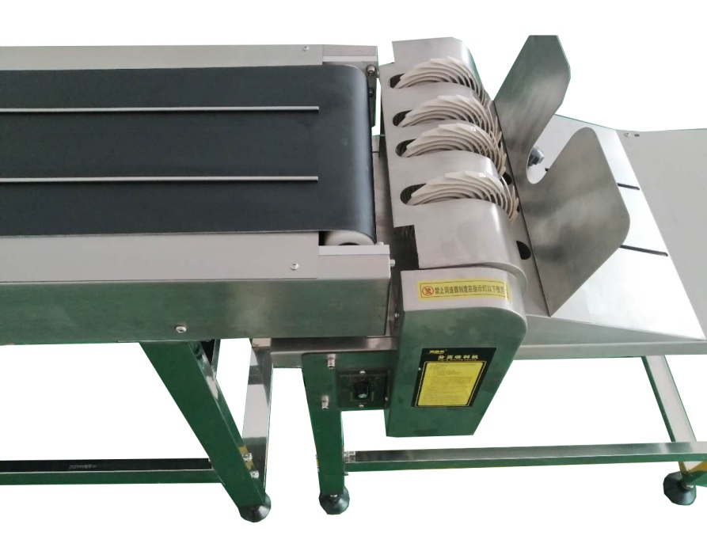
Paging Machines
Vacuum Model
Fraction Model

Slide 22
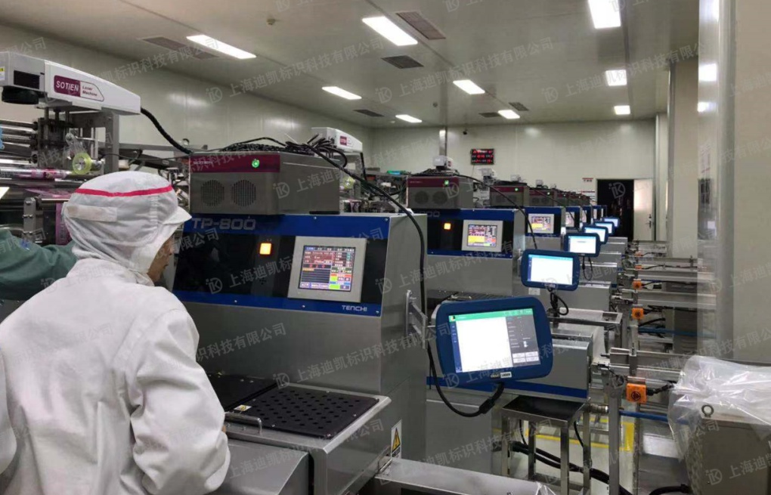
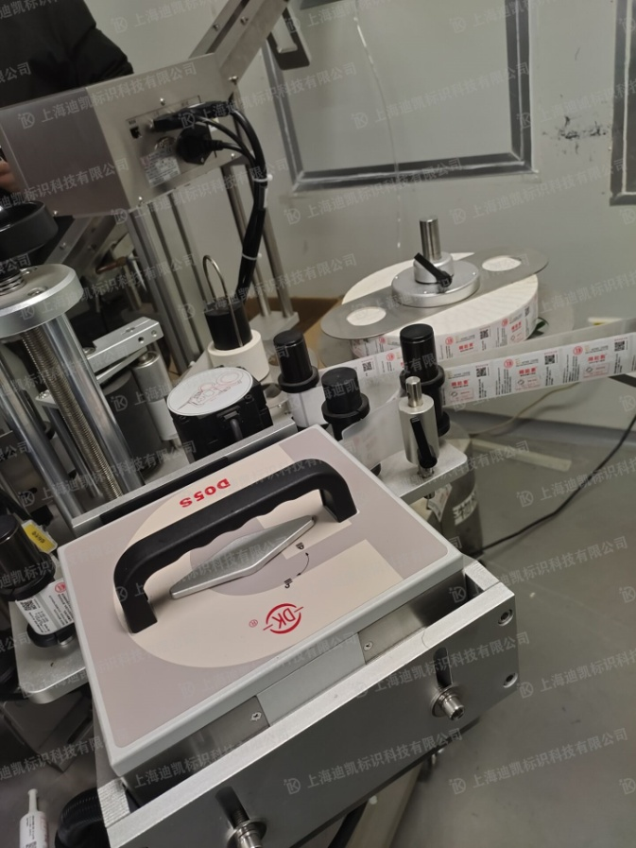
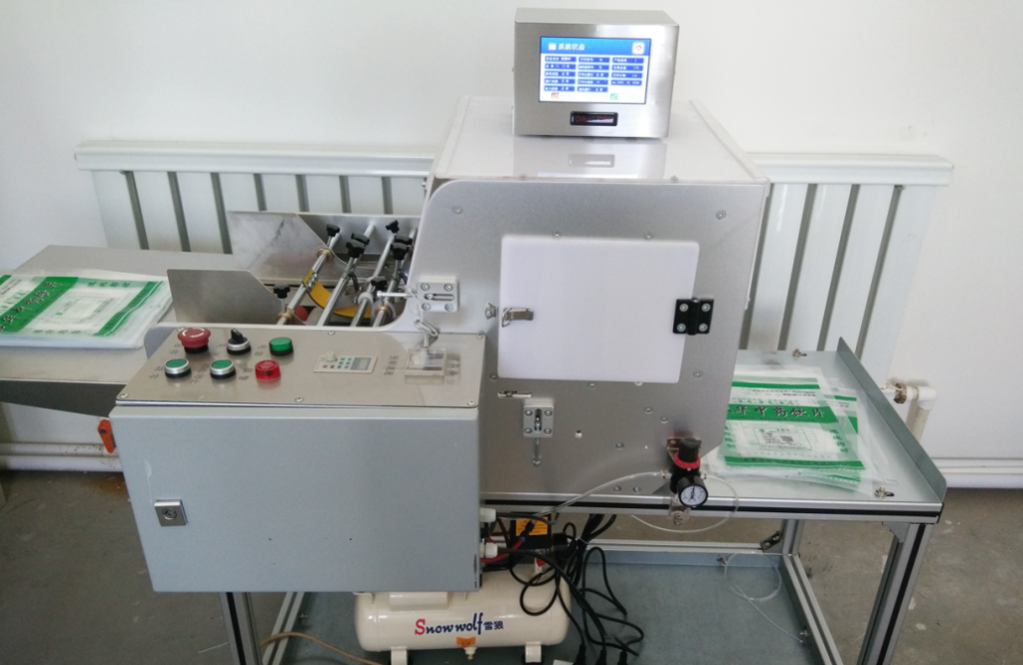
DK Solutions
1
Online application:
Labelling machine / Conveyor
TTO / Laser / Inkjet
2
Offline application:
Paging machine / Conveyor
TTO / Laser / Inkjet

Slide 23
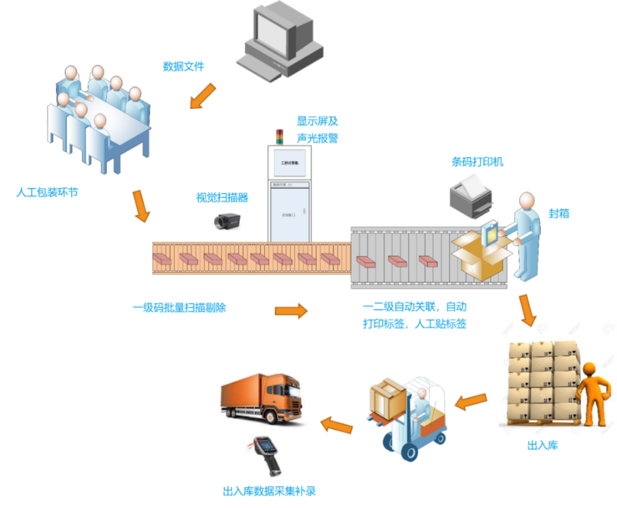
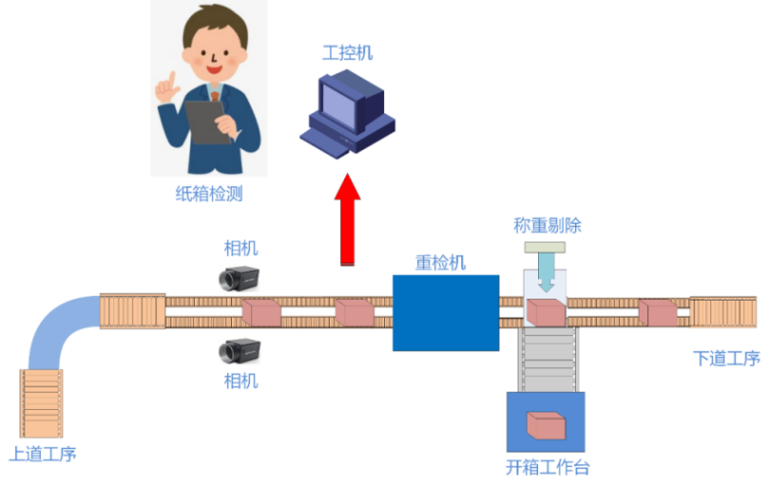
DK Solutions
1
Anti-Fake and anti-Fleeing;
Electronic Supervision Code;
UDI code;
2
Product Traceability and Industrial Coding Integration Solutions;
3
Intelligent Coding centralized control system;
4
OCR

Slide 24
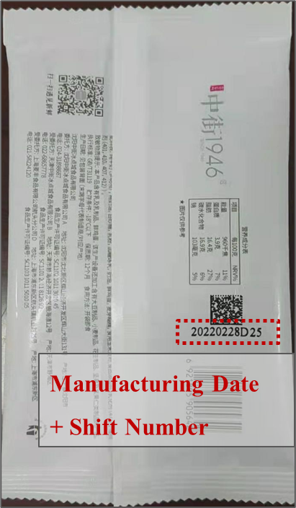
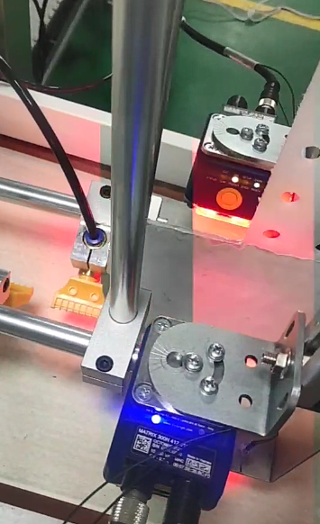
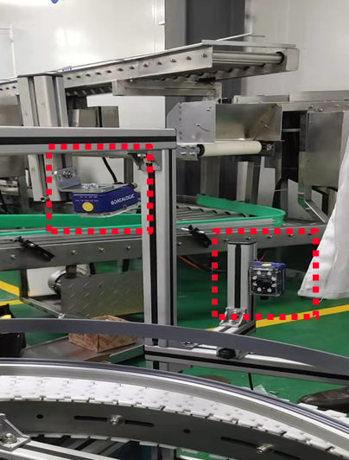
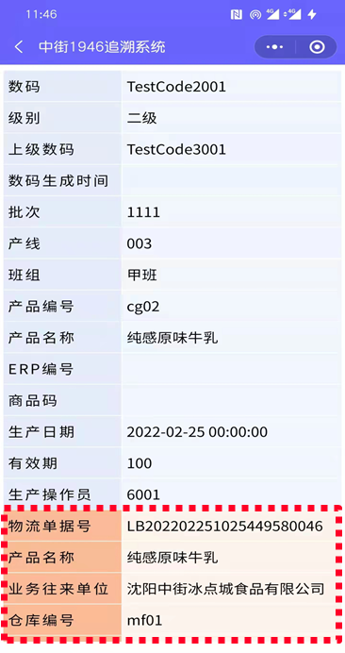
Application Cases
Full Life Cycle Traceability System
- ZHONGJIE1946 Tracebility of packaged food
DK Tracing System assign unique codes to each pouch
Use D series TTO to print codes
Inspect quality and scan codes after packaging
Collect and record data into groups
Associate product code with case code
Data management and inquiry by PDA hardware and system platform

Slide 25
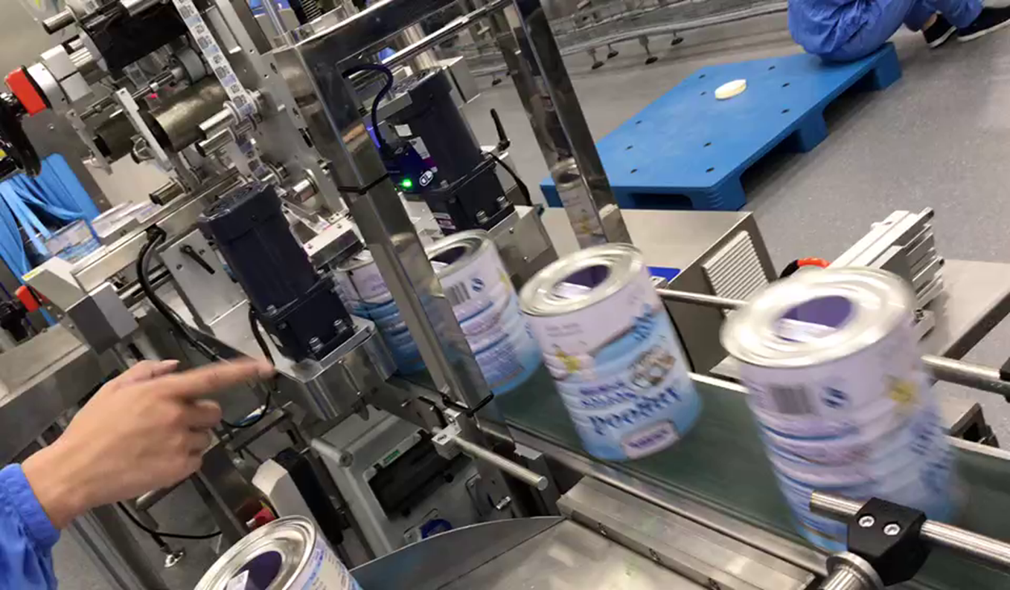
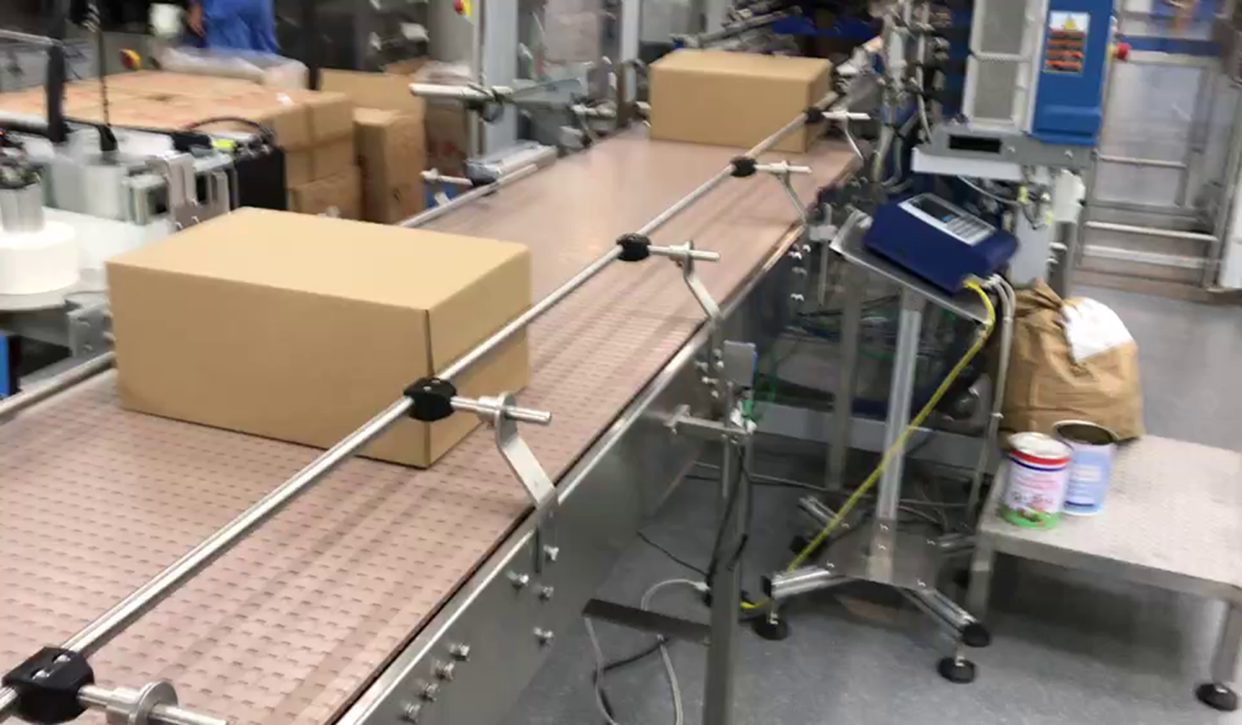
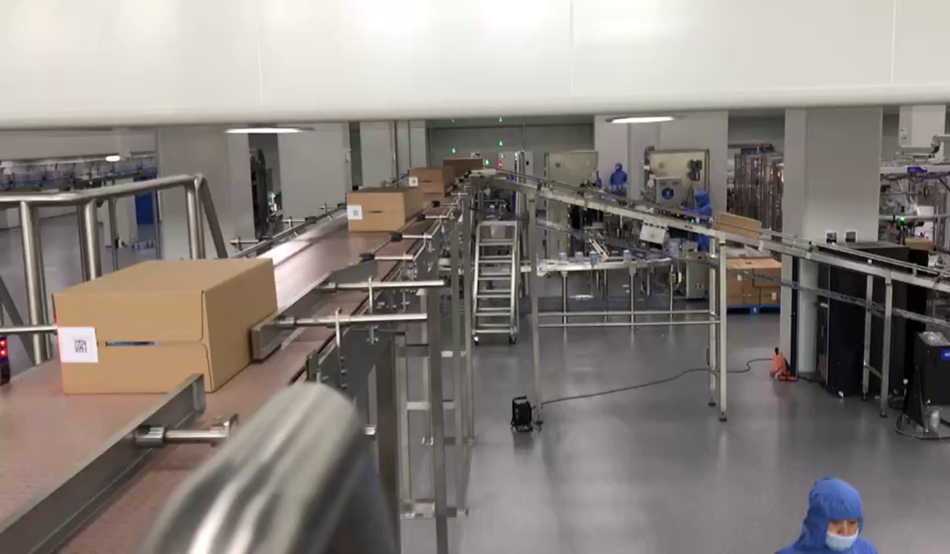
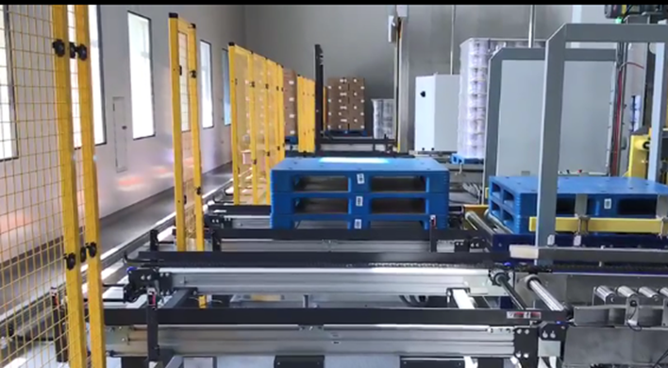
Application Cases
Scan logistics QR code and print product code by laser printers.
Associate logistics code with product code.
Scan product code before case packing and record data.
Print case code by DoD
Print content: product info, workshop and production line info.
Scan case code.
Build Case-Stack database.
Associate case code with stack code.
Scan stack code.
Associate stack code with warehouse code.
Send product info and code association to WMS.

Slide 26
Service System
Part Three
03
03

Slide 27

Service Concept
In Time
Solutions
解决方案
及时性
Value Added
Beyond Expected
增值
超预期

Slide 28

Service Concept
We have a service team with over 25 years experience, 24/7 standby.

Slide 29
Create Shared Value
Improve
Efficiency
(OEE)
Reduce
Waste
Increase
Productivity
Excel in
Compliance
Bring Value
to Packaging
Brand
Maintenance
Reduce
TCO
Optimize
Footprint
Environmentally
Friendly
Print& Read
Technology
Tracing
System
Packaging Line
Integration

Slide 30
Prospect
Part Four
04
04

Slide 31
New Product Development
01
02
03
04
TTO
New Generation
D series TTO
D241 Entry Level TTO
Laser
High Performance DLC/DLF/DLU series laser printer
Premium Picosecond Infrared Laser
Inkjet
DC910 Entry Level CIJ
High Speed DC940 series CIJ
Contact Coder
New Generation DK-1100

Slide 32
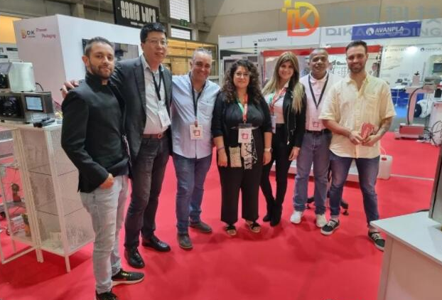


Overseas Business Activities
Continuous expanding business network
Attended Hispack Spain 2022, ProPak Asia 2022, Expo Pack Mexico 2022 & Pack Expo USA 2022.
Global tour of customer visits to deepen understand voice of customer and promote cooperation.
Preparation of overseas branches
UK assembling factory start-up.
Establish subsidiaries in Mexico and Brazil soon.
Europe & US subsidiaries under plan.

Slide 33
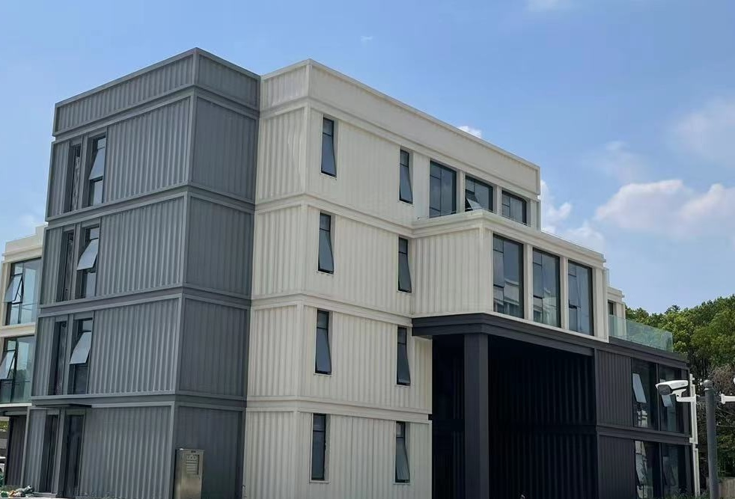
Headquarter Relocation
Relocate and expand headquarter office and manufacturing workshop to adapt growing business needs.
Workshop upgrade to deliver extra capacity and competitive advantages.
Relocation scheduled in Dec. 2022 and DiKai will start a new journey.
Make DiKai a world-trusted brand！

Slide 34
Thanks for your attention!
We Deliver Quality, Service and Reliability.

Slide 35
Cooperative Partners
35

